Slide 1
CIS212 Lab Week #2
Basic C Syntax – Libraries, Data Types, Conditionals, Loops, Functions

Slide 2
CIS212 Lab Week #2
Basic C Syntax – Libraries, Data Types, Conditionals, Loops, Functions

Slide 3
C Libraries
Why are they needed?
Contain basic functions/definitions for OS services.
Some common libraries in C:
stdio.h
stdlib.h
math.h

Slide 4
Using Libraries
Include the libraries that you will need to use at the top of your file
#include <LibraryFile>
More does not always mean better
(What will happen if you decide to include the 30+ libraries in your program?)

Slide 5
CIS212 Lab Week #2
Basic C Syntax – Libraries, Data Types, Conditionals, Loops, Functions

Slide 6
From None to All
In Python, you do not have to declare the type of your variable
var1 = 123
var2 = ‘a’
In C, you must declare the type!
int var1 = 123;
char var2 = ‘a’;

Slide 7
Basic (Primitive) Data Types
5 basic data types
int – integer
float – floating point value (such as decimals)
double – a double-precision floating point value (What does this mean?)
char – a single character
void – valueless, special purpose type
Why is there no Boolean type (true/false)?

Slide 8
The Scope of Variables
Time for some live coding!
Notes:
refer to https://www.geeksforgeeks.org/scope-rules-in-c/ for code examples to show (10 minutes max on this slide)

Slide 9
CIS212 Lab Week #2
Basic C Syntax – Libraries, Data Types, Conditionals, Loops, Functions

Slide 10
Conditionals in C
If, Else, and Else If
Good practice to make
sure your conditions
will work:
Make a flow chart!

Slide 11
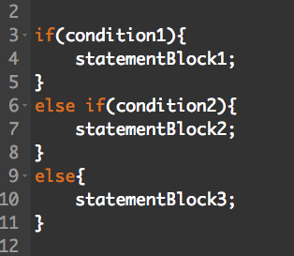
If, Else, and Else If
Condition: an expression that will evaluate to either true or false (If there’s no Boolean, what will evaluate to true?)
Statement Block: a group of statements to be executed if condition was true

Slide 12
CIS212 Lab Week #2
Basic C Syntax – Libraries, Data Types, Conditionals, Loops, Functions

Slide 13
Loops in C
When do you want loops versus if statements?
When you are doing the same statement block multiple times.

Slide 14
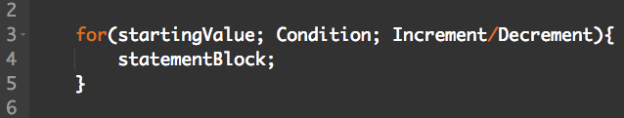
For Loops
Starting Value: value of variable to start loop at
Condition: an expression that will evaluate to either true or false in relation to the variable used for starting value
Increment/Decrement: how much the variable should increment or decrement after executing the statement block
Statement Block: a group of statements to be executed if condition was true
Notes:
provide example?

Slide 15
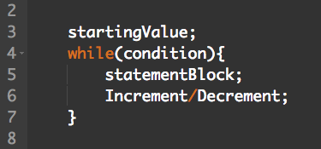
While Loops
Same as for loop!

Slide 16
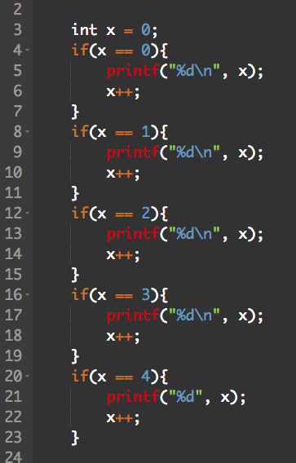
Practice!
What is a better way to write this?

Slide 17
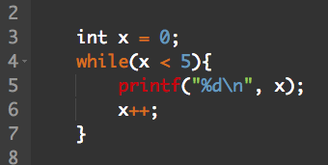
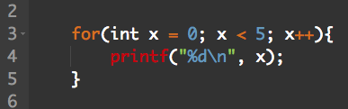
Two ways to do the same thing

Slide 18
CIS212 Lab Week #2
Basic C Syntax – Libraries, Data Types, Conditionals, Loops, Functions

Slide 19
Parts to a Function
return data type FunctionName (argType args) {
Body
}
return data type: the data type that the function is designed to return
FunctionName: the function’s name (best to be descriptive)
argType: the type of the input arguments
args: input argument variable names, each separated by commas
Body: the statements executed when the function is called

Slide 20
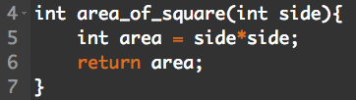
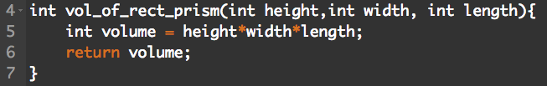
Example Functions
One argument:
Multiple arguments:
No arguments? No return value?

Slide 21
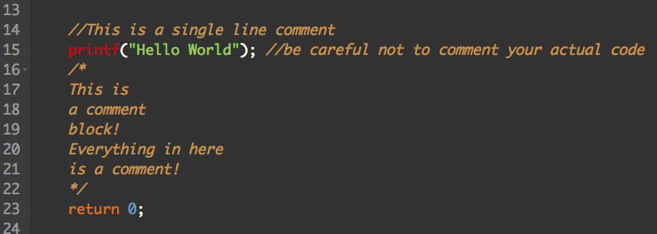
How to be a Good Programmer!
Write out some pseudocode if you are stuck (before you resort to Google)
Comment your code!

Slide 22
Start the Exercise…
As always, you may use Google and man to help you answer any of the questions!

